Slide 1
2015 Project Excellence Awards

Slide 2
US 31-W WARREN COUNTY
Intersection Realignment
Notes:
District 3 Intersection Improvement Project by Stewart Lich

Slide 3
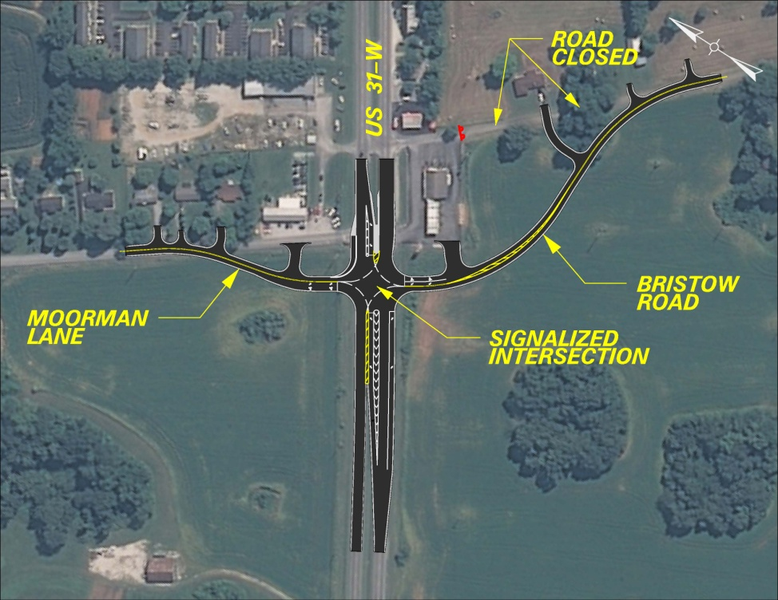
INTERSECTION REALIGNMENT ON US 31-W AT MOORMAN LANE AND BRISTOW ROAD
Existing layout
Proposed layout
Notes:
Was third ranked project in 2011 plan and all phases funded in 2012 plan.

Slide 4
US 31-W LOOKING SOUTH
BEFORE
AFTER
Notes:
Urban Minor Arterial with +20k ADT (7.8% trucks). Unsignalized offset intersection with commercial access points in vicinity.

Slide 5
US 31-W LOOKING NORTH
BEFORE
AFTER
Notes:
Linkage between Bowling Green and Transpark Industrial Complex. Had 42 accidents within 5 years with a CRF > 1.0

Slide 6
REALIGNED ROADWAYS
MOORMAN LANE
BRISTOW ROAD
Notes:
Everyday Counts initiative had been rolled out a few months after project started. D-3 used this strategy to get 100% utility participation at PL&G and requested funds immediately afterwards. Early right of way involvement allowed coordination with the building and access points of a new IGA.

Slide 7
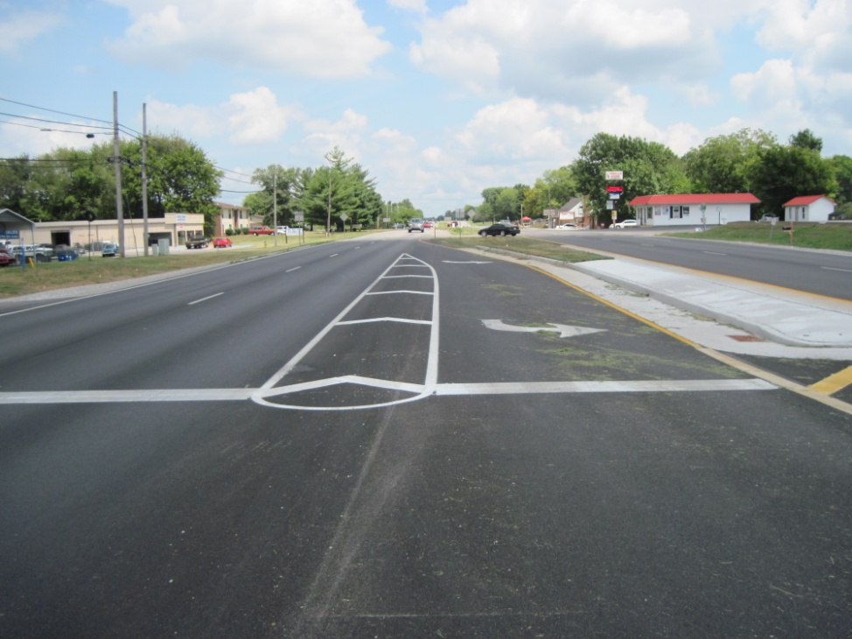
LEFT TURN LANES
NORTH BOUND
SOUTH BOUND
Notes:
With existing depressed median provide opportunity to construct left turn lanes with positive offsets which provides better sight distance for turning vehicles.

Slide 8
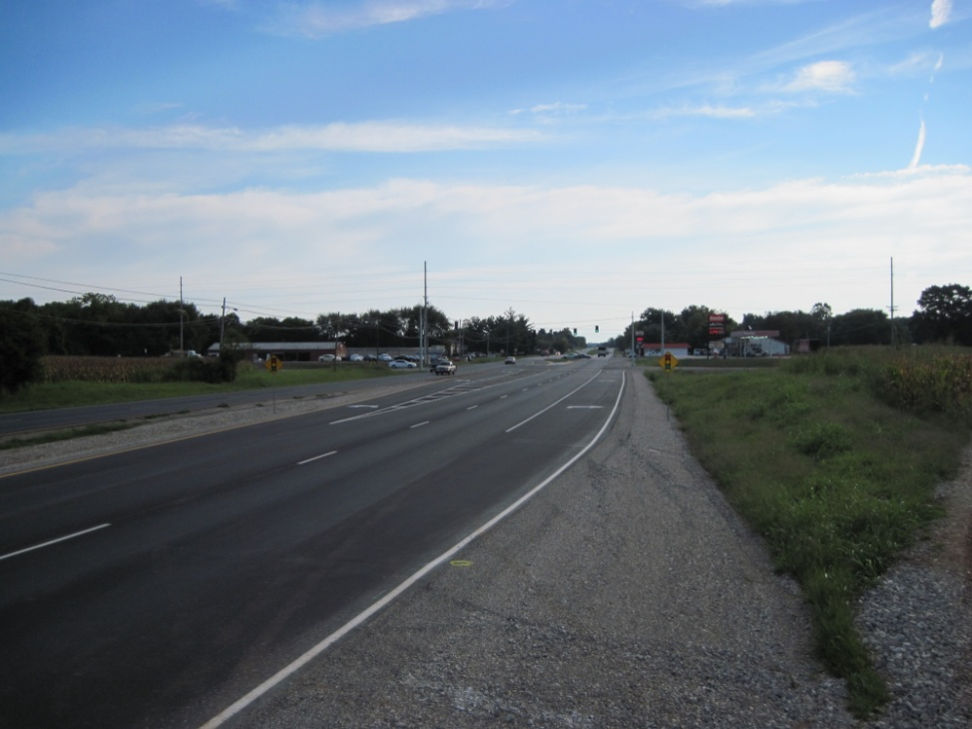
ADDITIONAL FEATURES
ACCESS MANAGEMENT
NEW RIGHT TURN LANE
Notes:
Raised median provided access management device to eliminate left turns into Jr. Food Store.
In the end, the project began in Sept 2012 and Let to construction Oct 2014.

Slide 9
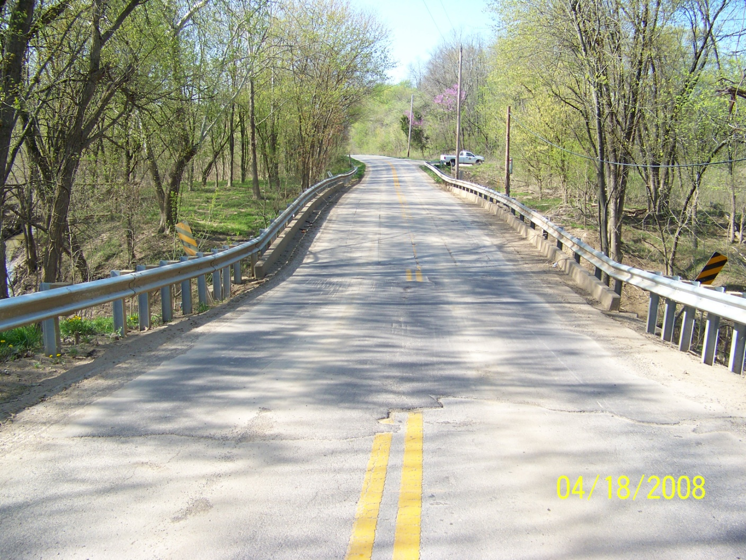
5-4000.00 KY 1494 over Long Lick Creek – Emergency Bridge Replacement Bullitt County
Existing roadway showing failing north end bent. Several lifts of asphalt had been placed at the north end of the structure to allow a smooth transition to the bridge due to the sunken roadway.
Notes:
District 5 Emergency Bridge Replacement Project by Tim Shown

Slide 10
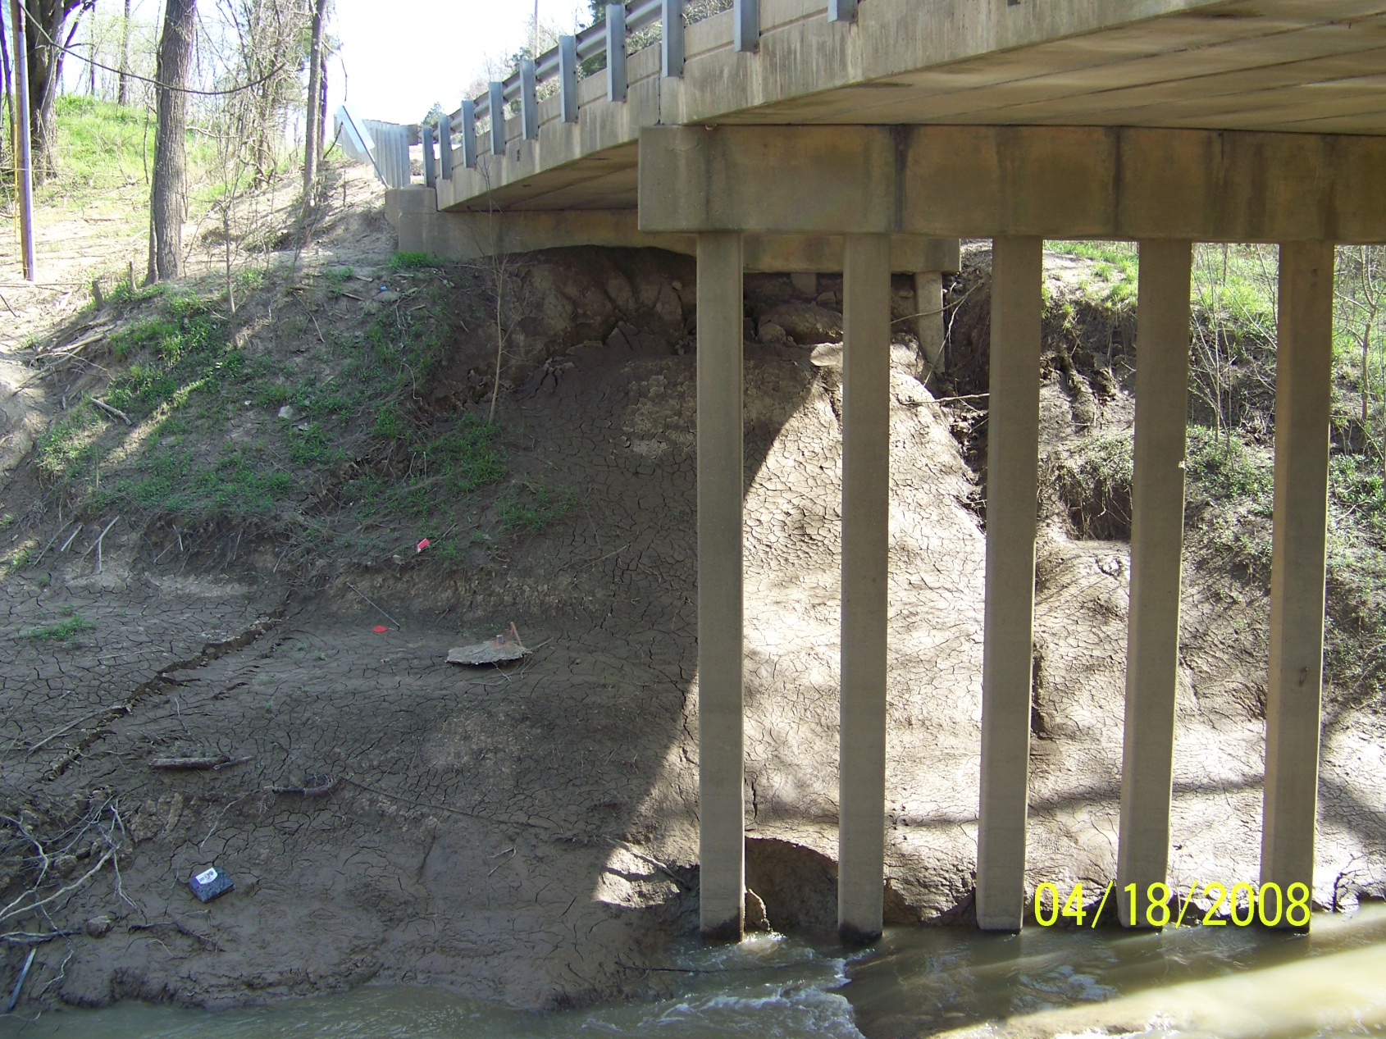
Existing north abutment showing the effects from scour and a leaking waterline located along the upstream side of the bridge. Archival plans of the existing bridge structure also show that existing pilings under the existing end bents did not reach bedrock. Proposed pilling for new end bents are to reach bedrock.

Slide 11
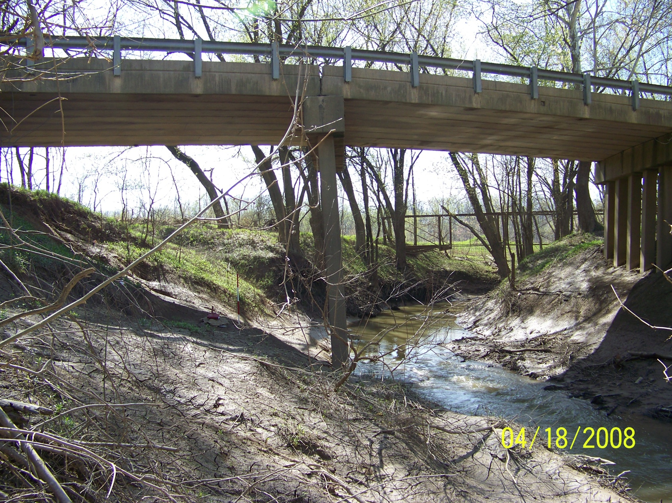
25’
Existing Pier One showing the effects from the failing north end bent.
Note the separation of existing box beams at the top of the tilted pier.

Slide 12
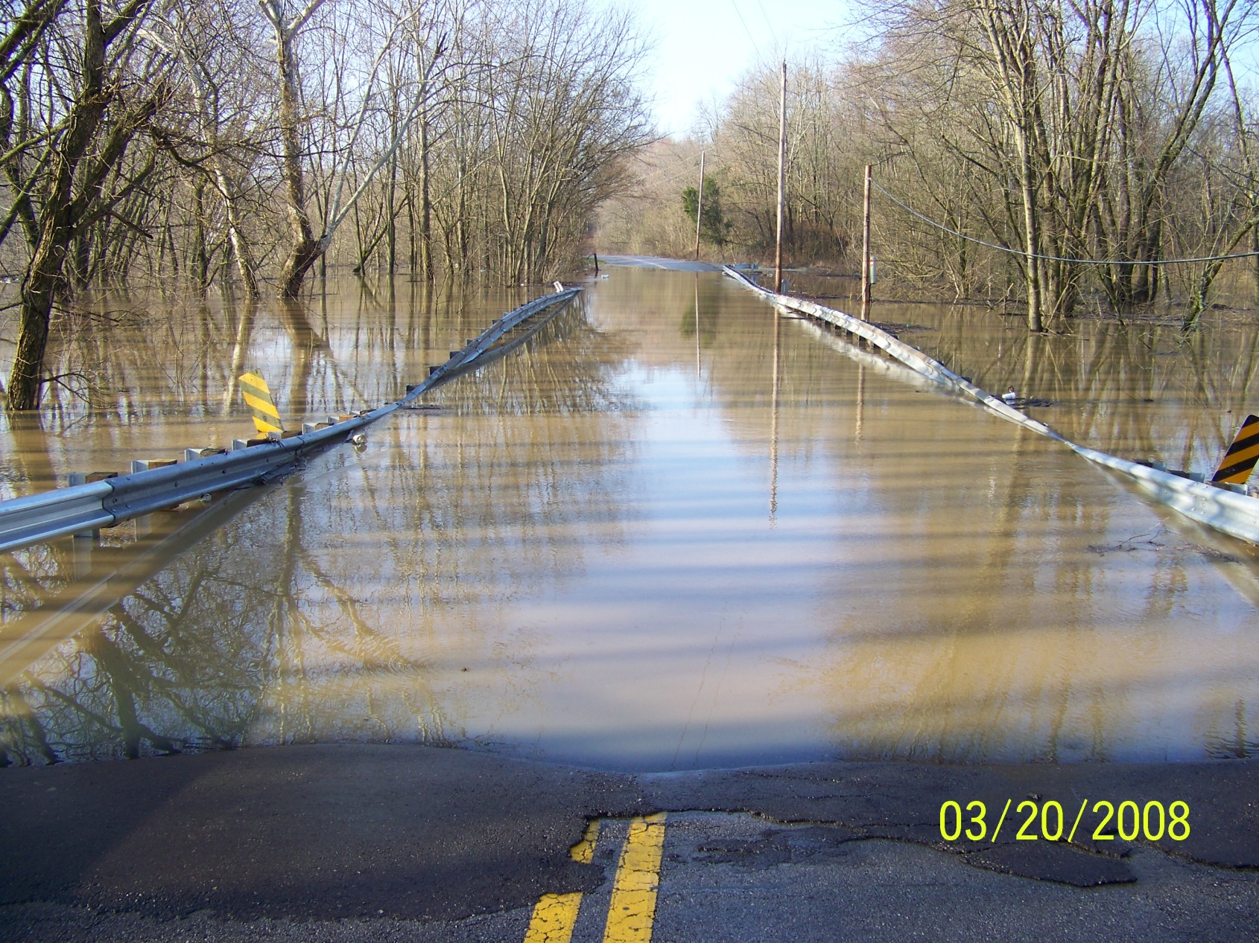
And yes, the water does get up in this area. Most of the reason for the overtopping of the bridge is to due to the close proximity of Salt River and backwater from the river traveling up Long Lick Creek during significant rain events. The contributing drainage area to this bridge is 30.9 square miles.
Notes:
Receding waters also accelerated scour issues. Also located in FEMA floodplain. Considering the worsening conditions of bridge accelerated the design and replacement.

Slide 13
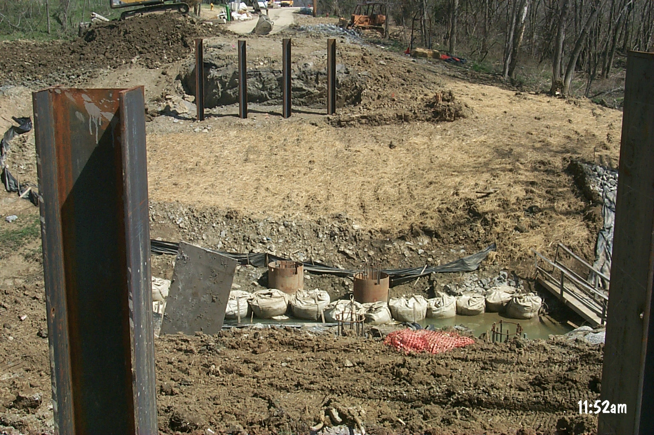
The roadway was closed for construction and maintenance of traffic handled by way of detour. The entire structure was removed prior to construction. Shown are newly constructed pilings for end bents and drill shafts for relocated piers.

Slide 14
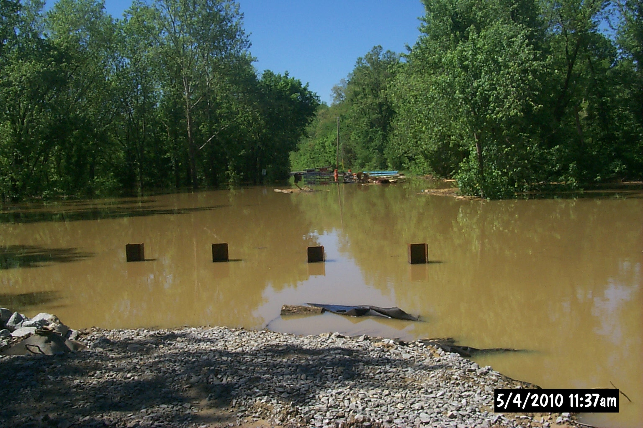
Mother nature did pose some problems and delays during construction.
Just sticking out of the water line in the foreground are the pilings for the north end bent.

Slide 15
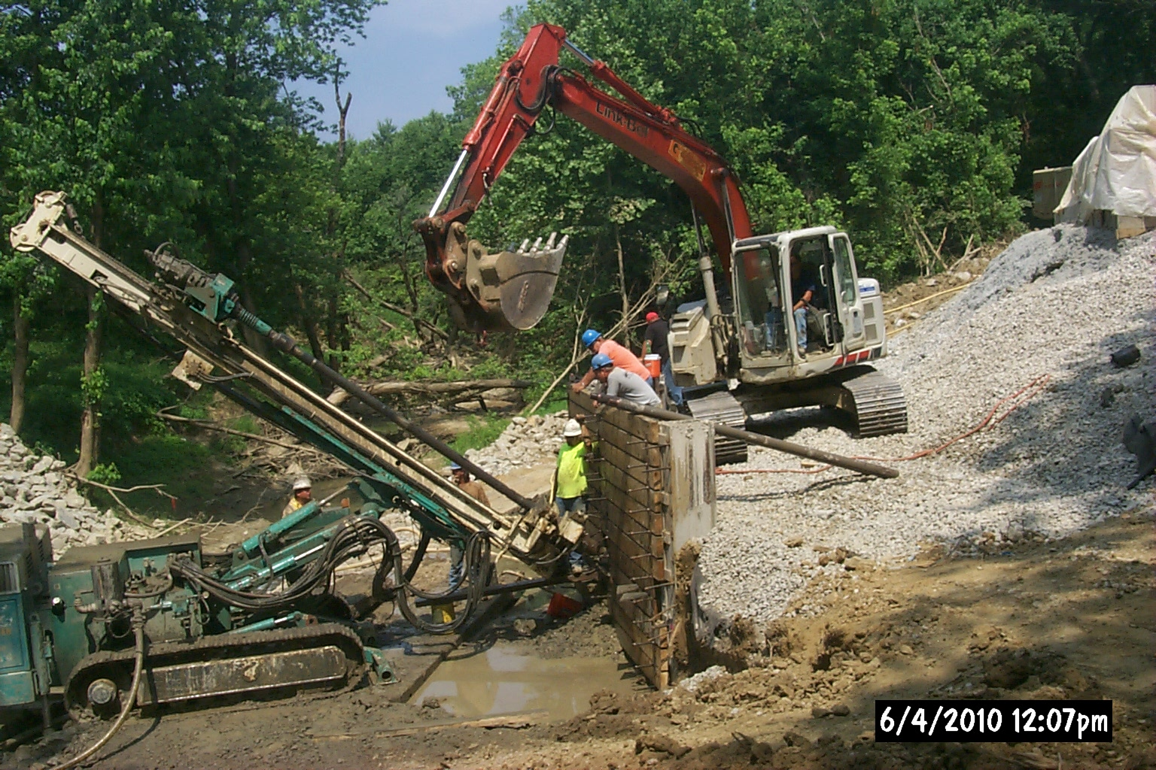
Tie-Back Wall construction showing the installation of anchors thru the proposed wall. Survey points and slope inclinometers were installed on the wall to monitor performance of the wall during and after construction.

Slide 16
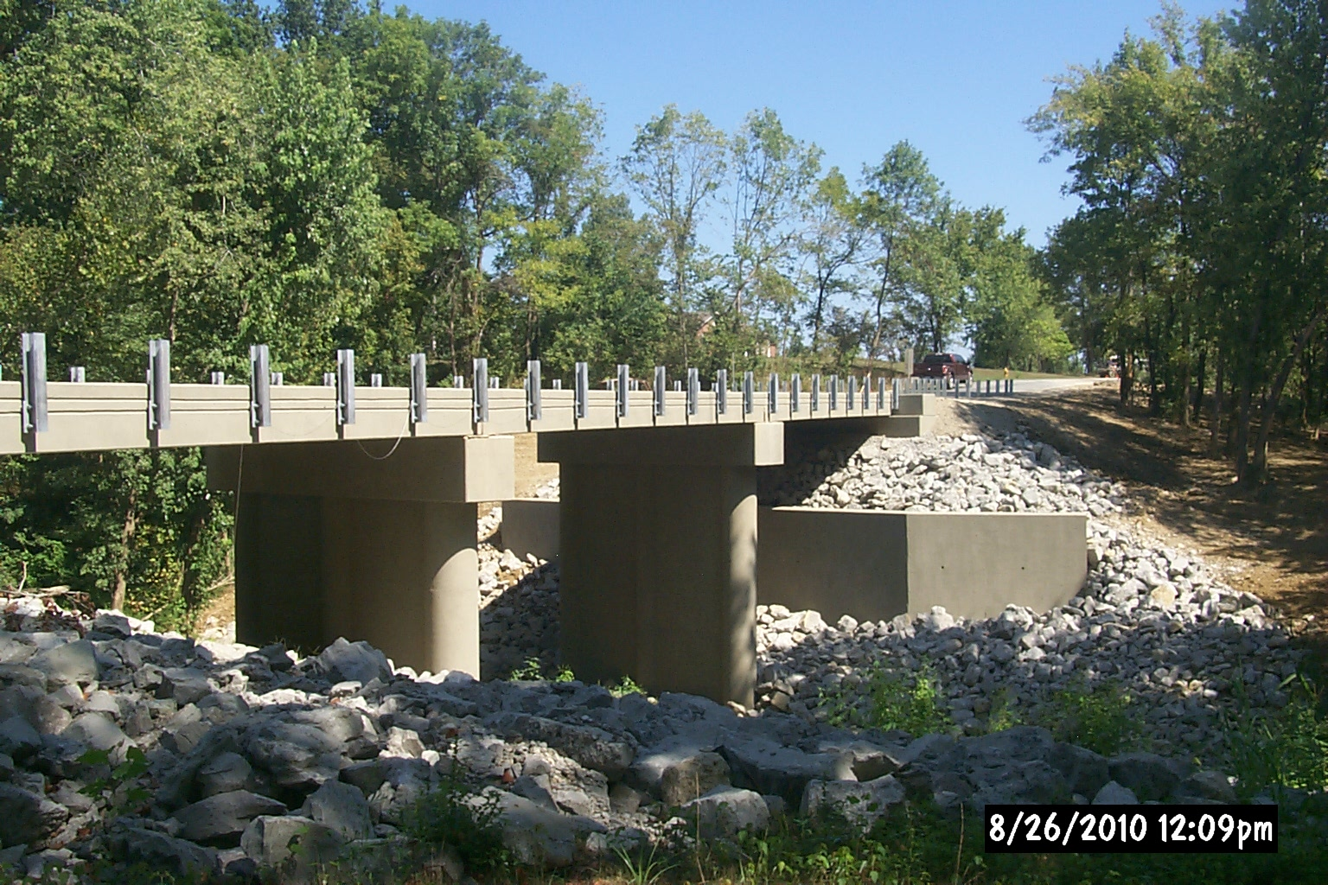
View from southern end on the upstream side of the new structure prior to the completion of guardrail work.

Slide 17
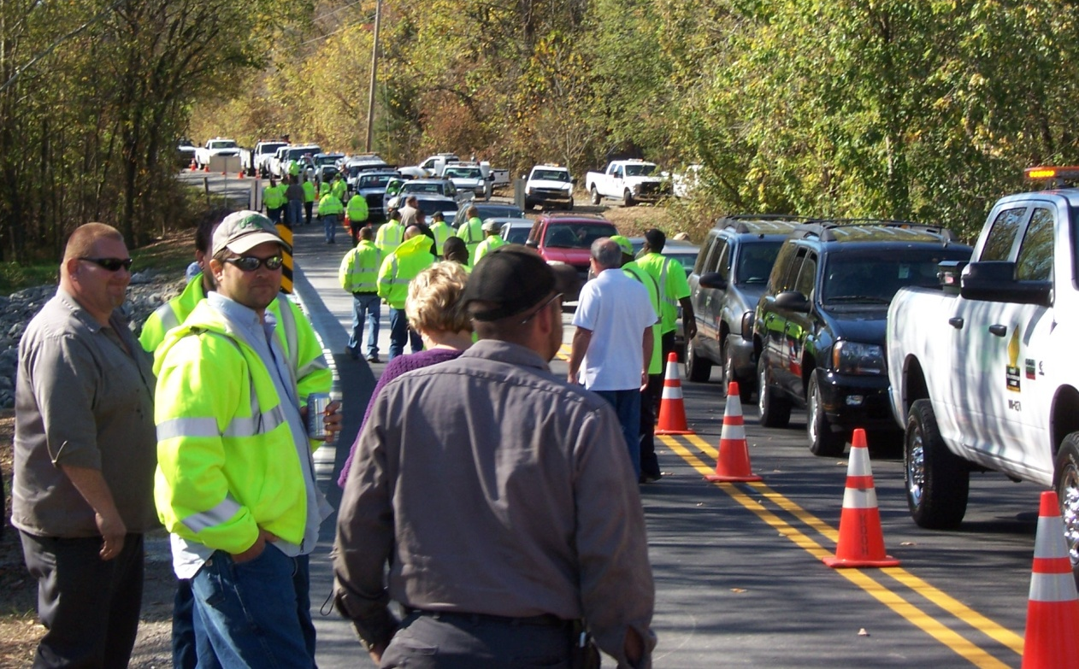
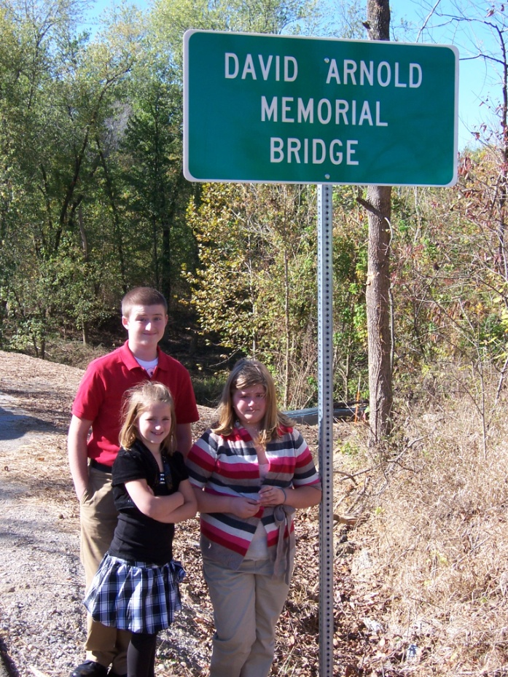
DISTRICT FIVE
Family, friends and co-workers gathered on October 15, 2010 at a sign unveiling naming the newly constructed bridge on KY 1494 in Bullitt County in David Arnold’s memory. He was Superintendent II of our Bullitt County Unit when he passed away on Thanksgiving morning 2009 at the age of 33. He had been employed by the Transportation Cabinet since August of 2002. Vehicles lined the roadway as employees from across the district joined with David’s family to dedicate the bridge on Beech Grove Road in remembrance of his hard work and dedication.
Notes:
Good work by D-5.

Slide 18
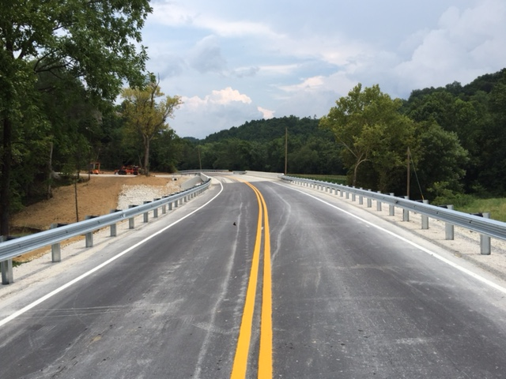
ST. HELENS BRIDGE REPLACEMENT PROJECT
ITEM # 10-295.00
LEE COUNTY
KY 52
Notes:
District 10 Bridge Replacement Project by Min Jiang

Slide 19
Timeline
10-295.00
March 9th
Survey
March 16th
Drilling
April 3rd
Contacted Utility Owners
April 9th, ROW Certification
April 20th, CE Completed
March 25th
Contacted Property Owners
April 8th
Geotech Report Issued
April 9th
Roadway Plans Submitted
April 24th
Project Let to Construction
April 27th
Utilities Relocated
Notes:
Large WPA-era box culvert collapsed leaving KY 52, a major collector route, inoperable.

Slide 20
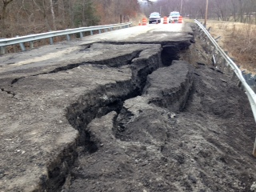
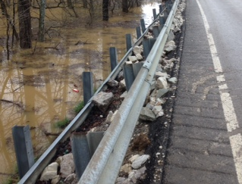
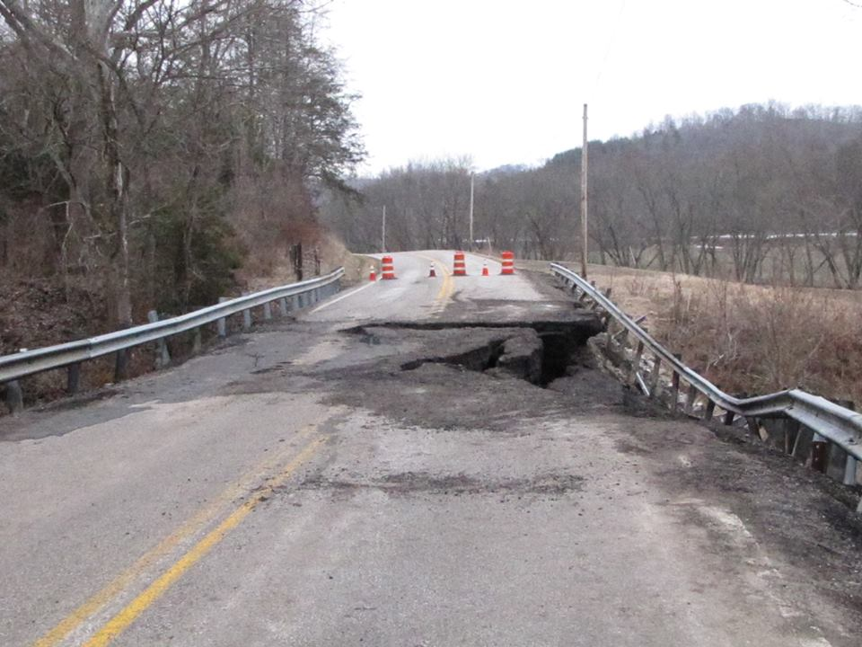
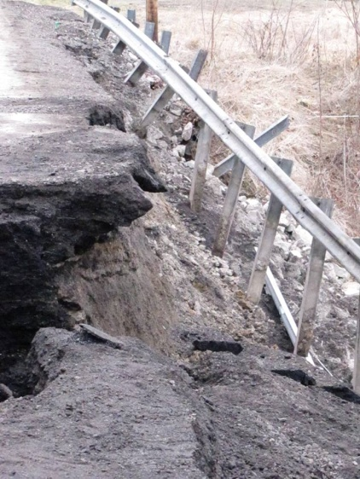
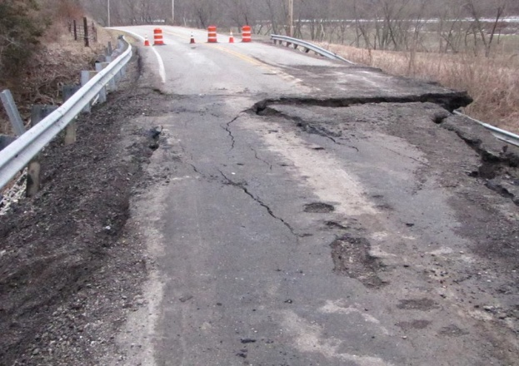
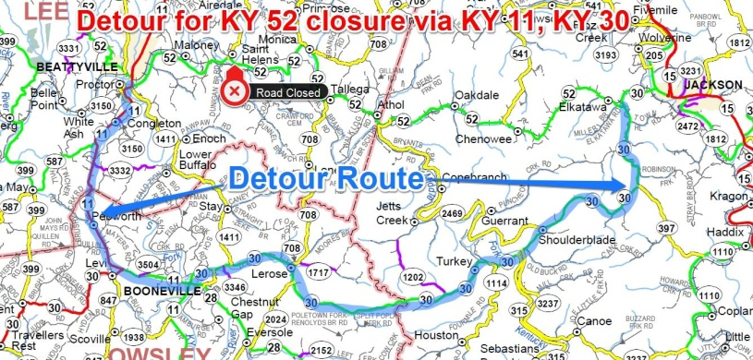
EXISTING CONDITIONS
10-295.00
Heavy rain and flooding between
March 6th-March 8th
caused the existing structure to collapse.
Notes:
The adverse travel is around 20 min.

Slide 21
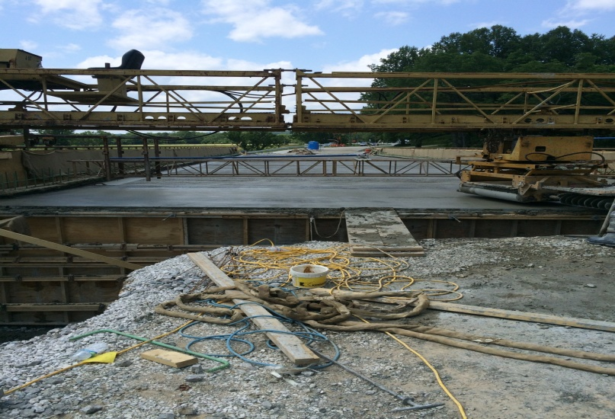
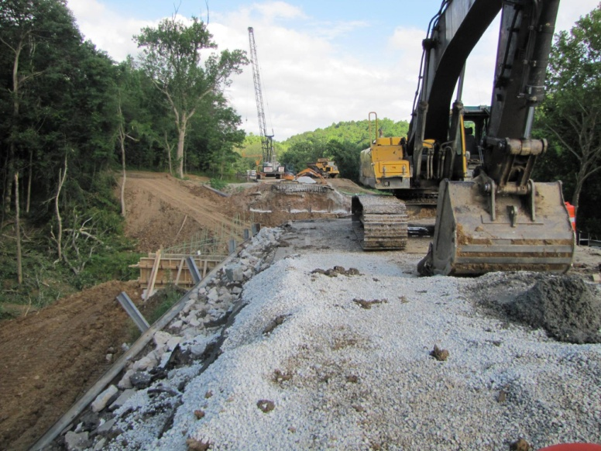
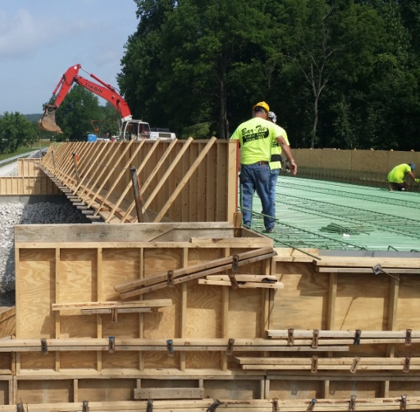
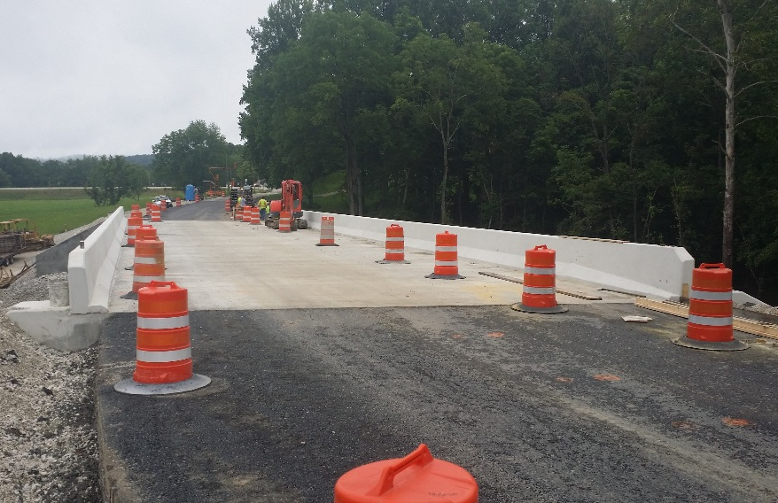
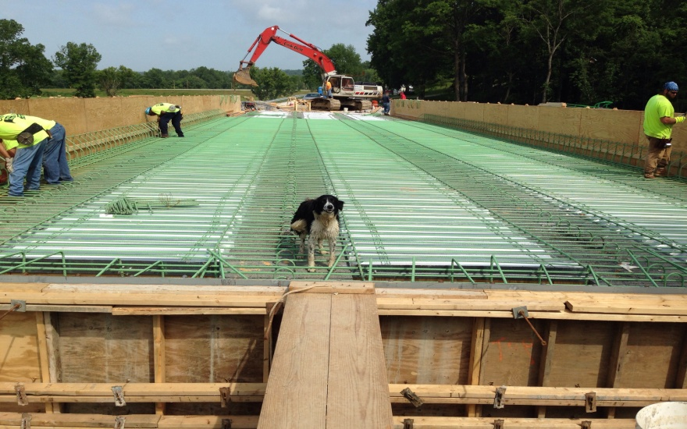
CONSTRUCTION
10-295.00
Notes:
Before the expedited construction phase began, the trees that provided a roosting habitat for endangered bates, needed to be cleared.

Slide 22
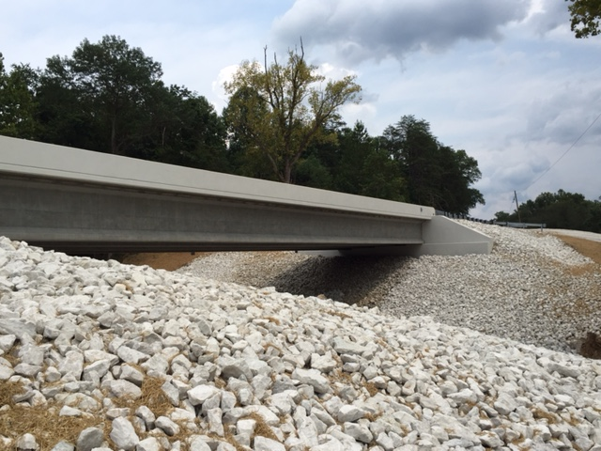
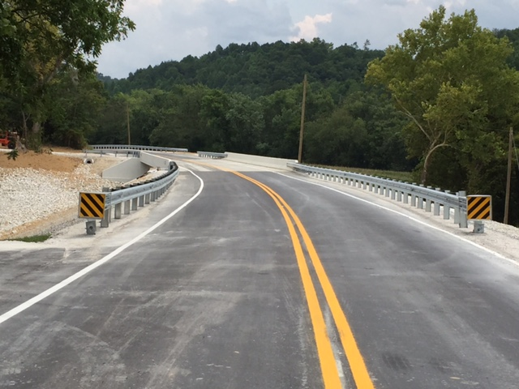
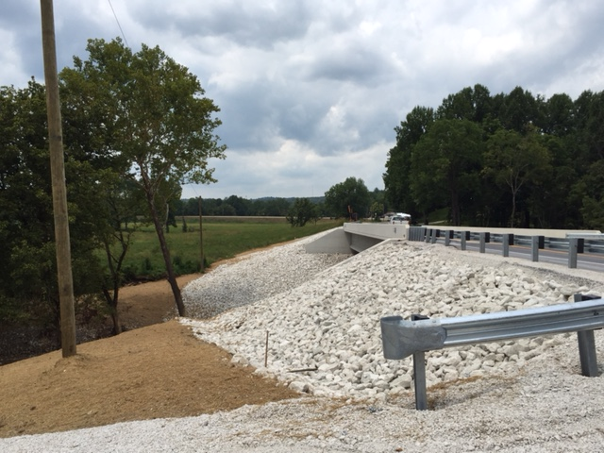
POST CONSTRUCTION
10-295.00
Through a collaborative effort between various disciplines within the cabinet working toward a common goal, the project was let to construction on April 24.
Notes:
Extremely compressed schedule. Seven weeks from survey to construction. Another example of fine work by the Cabinet’s work.

Slide 23
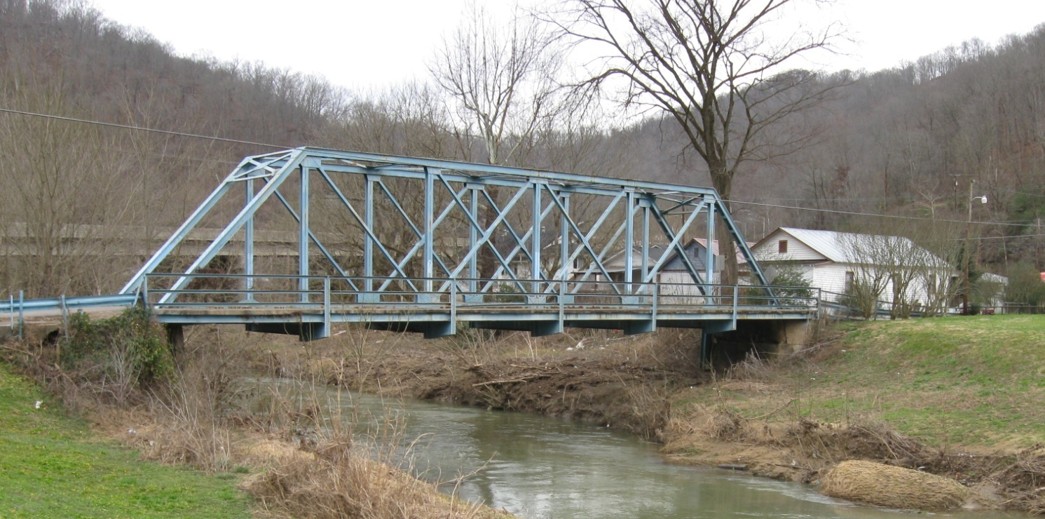
12-1085 KY 777 Bridge Replacement at Garrett Floyd County
Notes:
Lastly is a District 12 project submitted by Chris James.

Slide 24
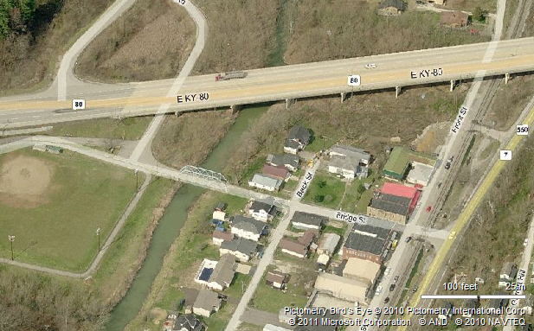
Project Location
To Prestonsburg
KY 80
Project Location
Notes:
One of the most interested aspects of this submittal is the narrative from a Bridge’s point of view.
The bridge gave it’s autobiography, mentioning that it was bypassed so to speak when KY -80 was reconstructed in the late 1970’s.

Slide 25
Existing Conditions
One-Lane Steel Truss Bridge
Approx. 11.5’ wide with 3.5’ sidewalk
Single Span (approx. 100’)
Opening Area = 1,471 sq. ft.
Sufficiency Rating = 3
Built in 1944
Eligible for National Register of Historic Places
Approx. 16’-18’ wide approaches
ADT
2008: 640
2028: 800
Notes:
Bridge was still used to primarily access the old high school which later relocated a few miles away as Allen Central and the old building was demolished. There was consideration of removing the bridge completely. Through public outcry via Facebook and the need to provide alternate access to baseball field, walking track, and picnic shelters it was decided to keep the crossing.

Slide 26
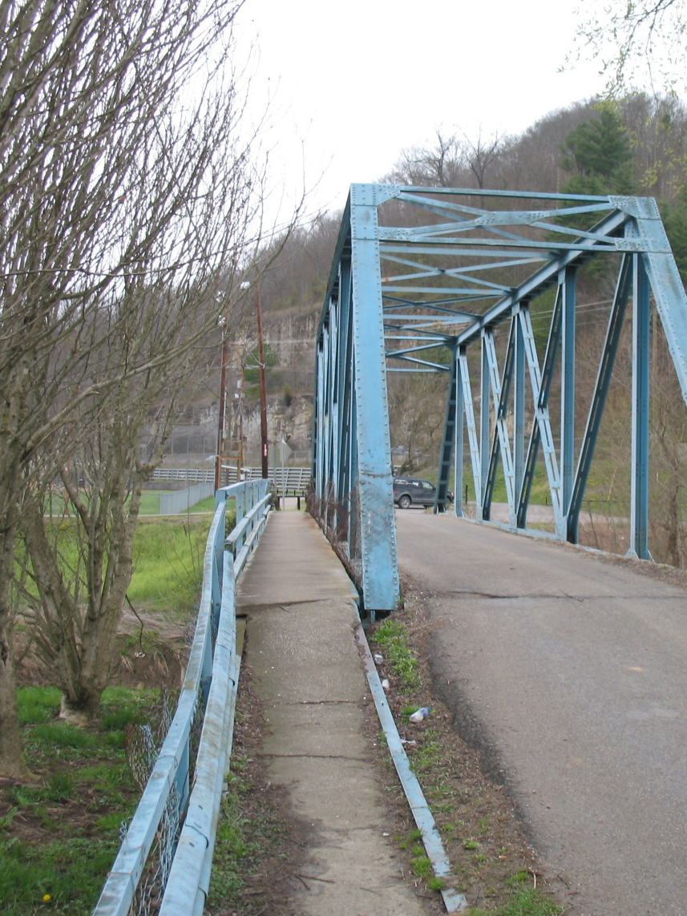
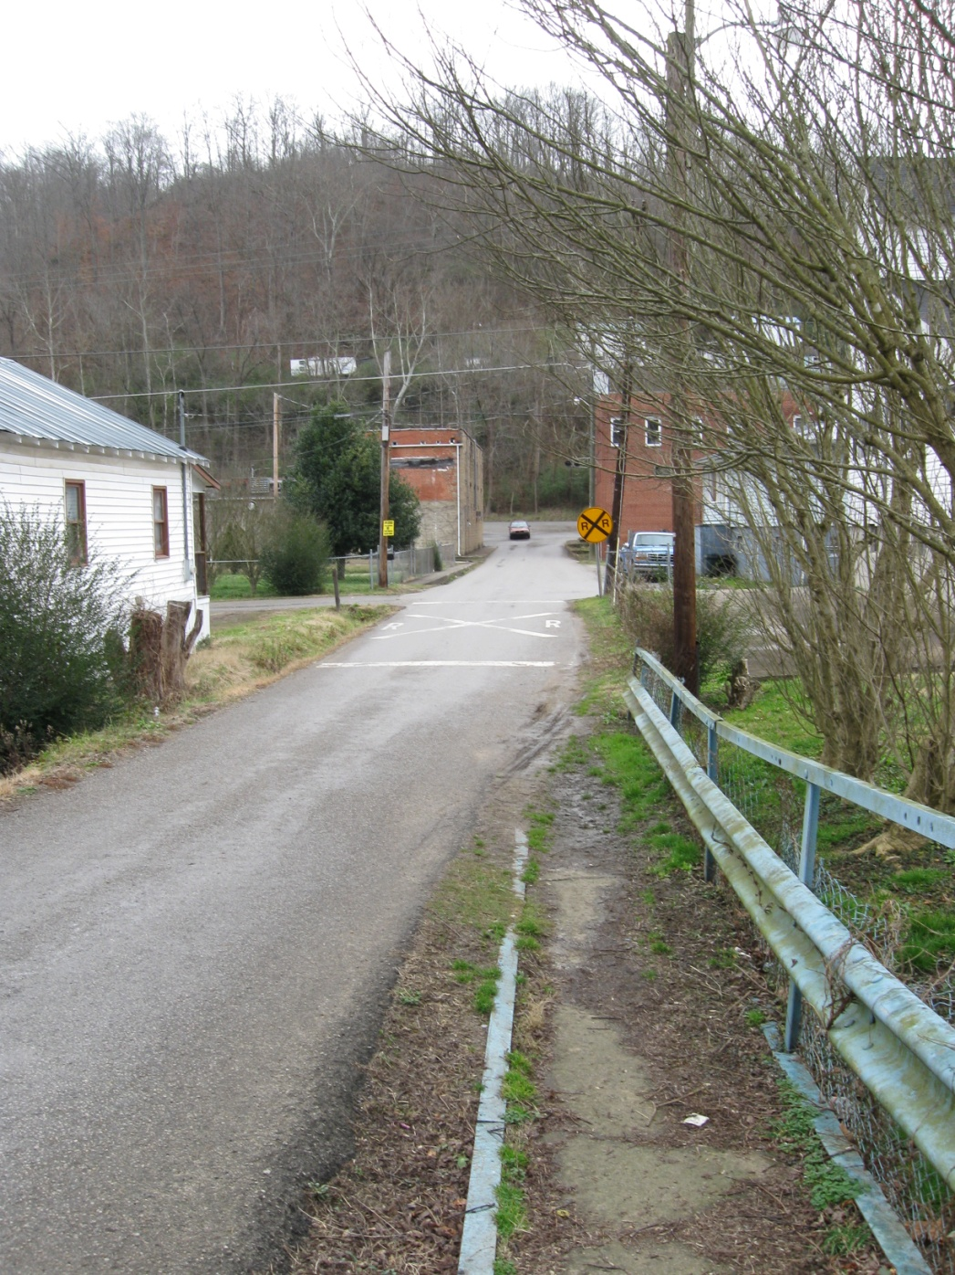
Notes:
Connection from downtown Garrett to park.

Slide 27
Alternates
 | Right of Way | Utilities | Construction | TOTAL
Alternate 1 – Repair Existing | $48,500 | $35,000 | $730,400 | $813,900
Alternate 2 – Spread Box Beam Bridge | $159,700 | $45,000 | $643,617 | $848,317
Alternate 3 – Thru-Girder Bridge | $152,200 | $40,000 | $898,216 | $1,090,416
Alternate 4 – Truss Bridge | $152,200 | $40,000 | $1,068,301 | $1,260,501
Alt. 1-Preferred
Low traffic volumes utilizing the bridge
Emphasis to preserve truss bridges
Based on structural inspection, relatively good condition of truss
Lowest project cost of all alternates
Notes:
Alts considered.

Slide 28
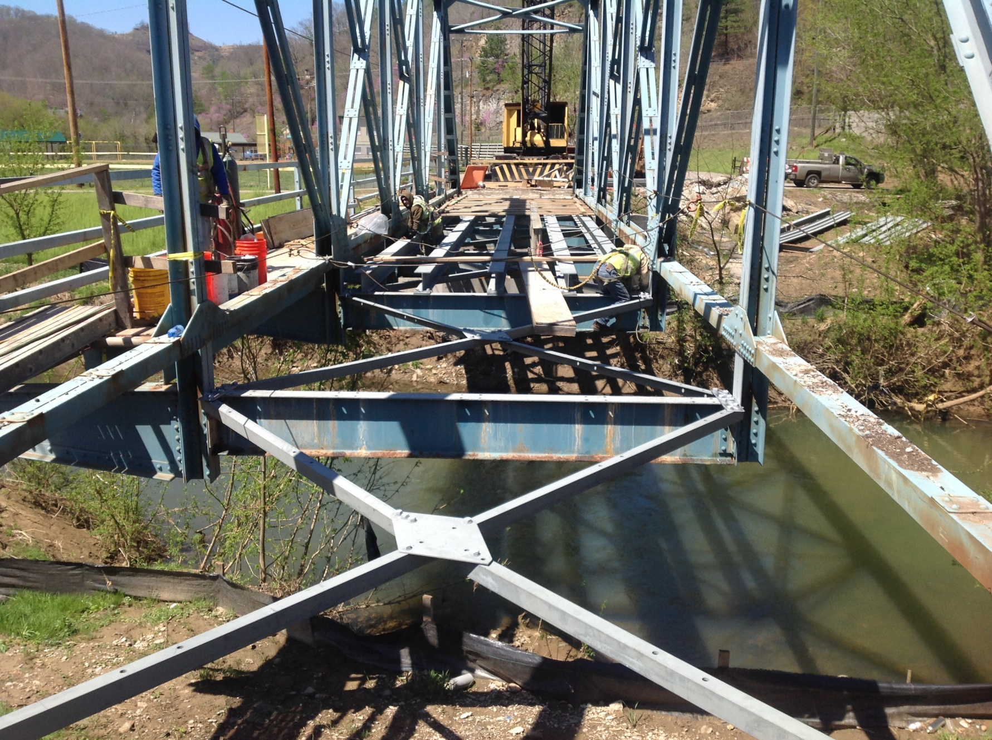
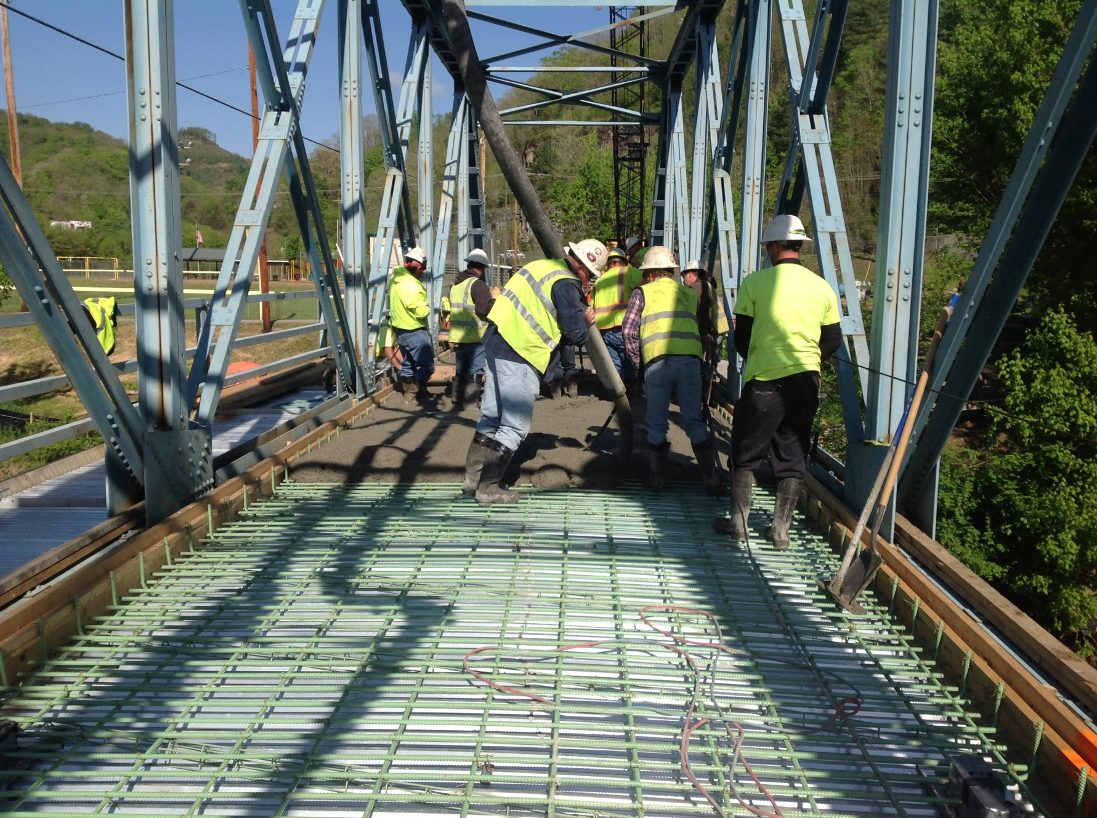
Deck Removal
Deck Reconstruction
Notes:
Bridge received a new deck.

Slide 29
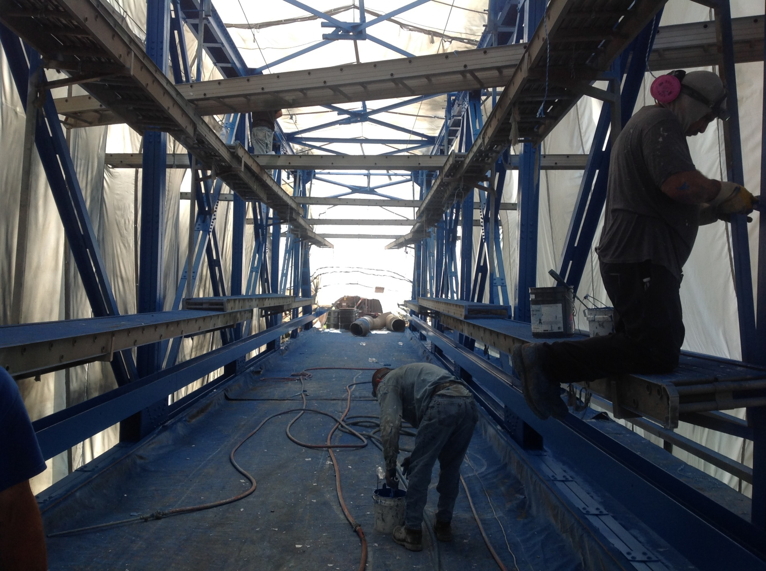
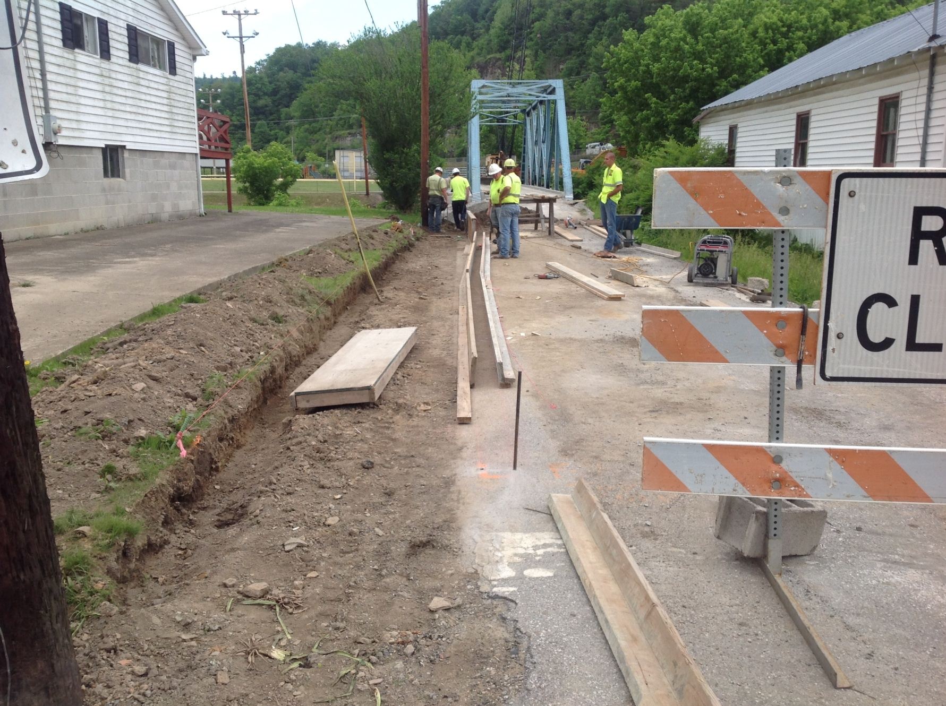
Paint Process
Approach Work
Notes:
New paint and sidewalk.

Slide 30
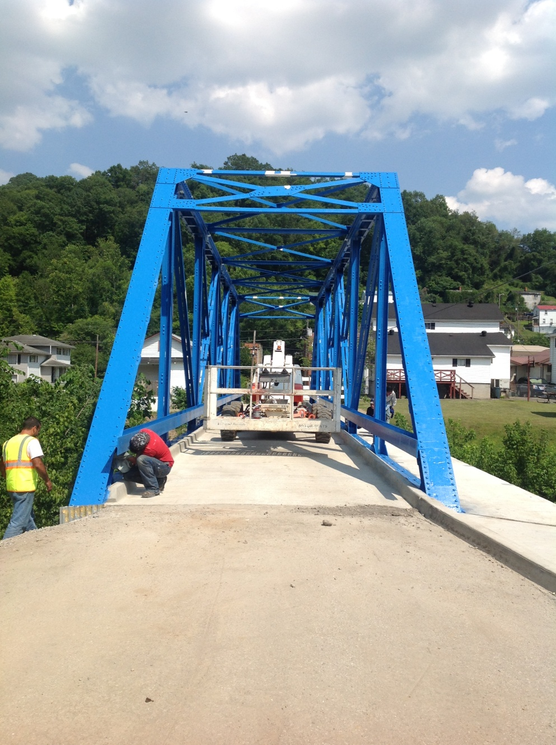
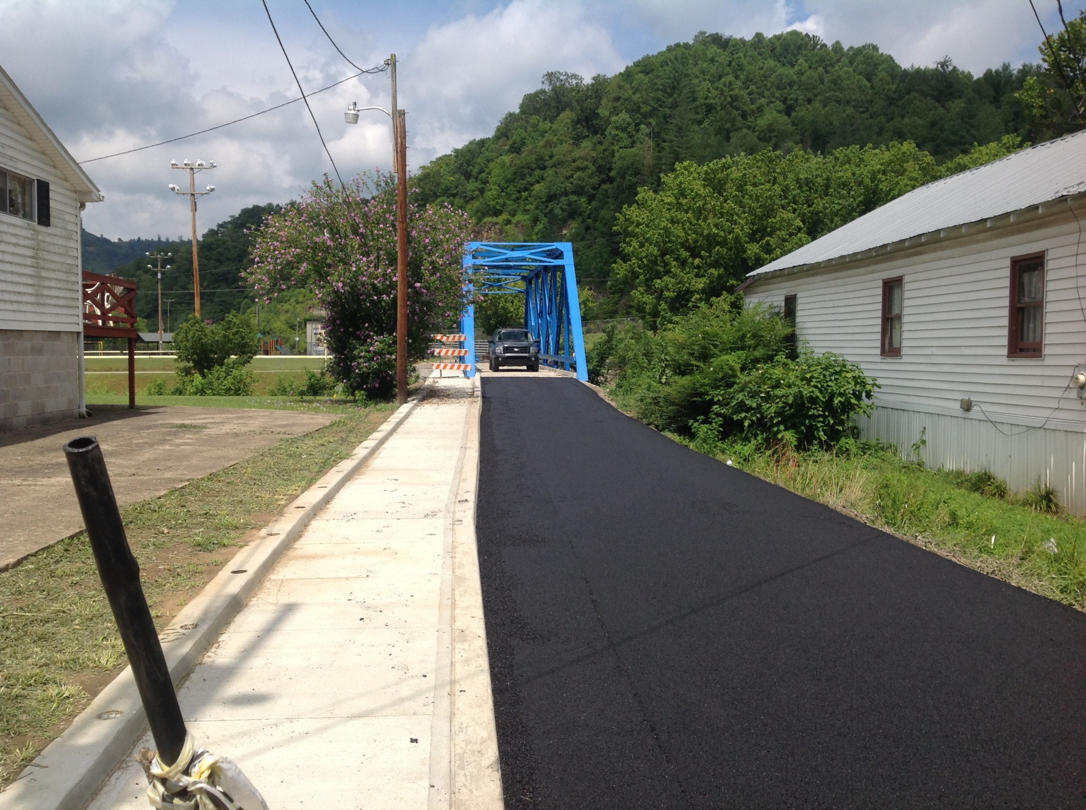
Approach Work
Nearly Completed
Notes:
Interesting is that the bridge was going to be orange to which the bridge responded “What is this, Tennessee?” Orange was the school color of the old Garrett High school.

Slide 31
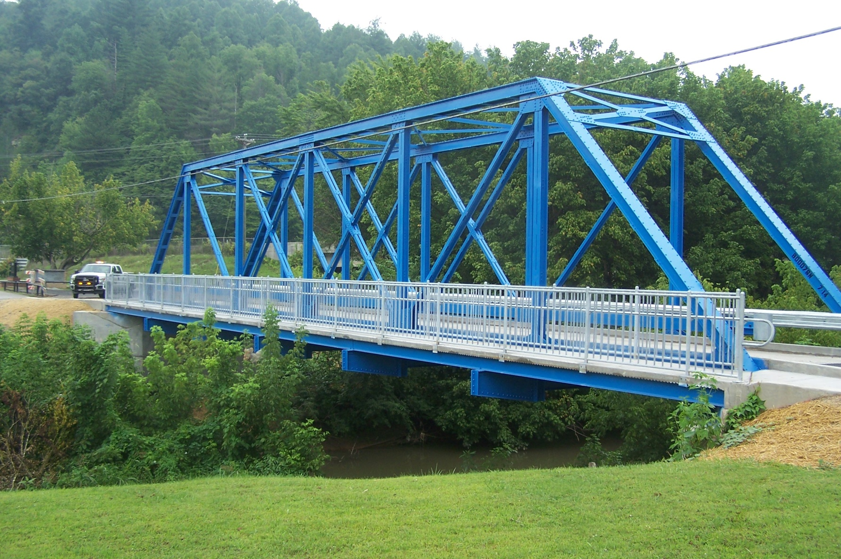
Finished Bridge
Notes:
Fortunately contract could not obtain this color as specified in the contract so became a brighter blue version of the previous version. A great story and another great project. Now for this years recipient of the 2015 Project Excellence Awards………

Slide 32
2015 Project Excellence Awards
Thank You!
Notes:
Before we announce the recipient would like to thank the submitters from Districts 3,5,10, &12. Would to thank the judges David Martin, Kevin Sandefur, and Jim Simpson. Would also like to thank Carolyn Weber, Jeremy Wooldridge, and John Wells in helping prepare the certificates and award.
Enjoy the rest of the conference!!!

